Slide 1
My ideal school
Diāna Alksne 8.b

Slide 2
Location, type of school, uniform.
My ideal school would be close to the city center, so that children would be more convenient.
My school will be day school, because I don’t really like boarding school and my school will be a mixed school.
In my school, there will be no school uniforms,child can clothe what he wants.

Slide 3
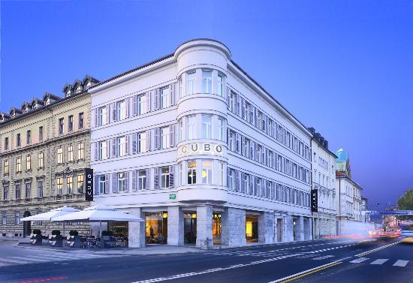

Slide 4
Rules
A student must be in school for at least 10 minutes before the start of lesson
There must be a change of footwear
In lessons should not use mobile phones

Slide 5
Facilities
Swimming pool
Sports arena
Computer room
Games room
Caffee
Dancing studio
Singing studio
Acting studio

Slide 6
Class, lunch, breaks
Number of students in each class will be forty.
There will be three lunch breaks. Two 25 min and a 40 min long.
Each breaks , with the exception of lunch breaks will be 15 minutes long.

Slide 7
Clubs, activities, trips, homework
Sport clubs- baseball,football,volleyball,basketball.
Activities- swimming, singing, dancing.
Trips-my school would travel to other countries, for children to learn new things about other countries
Homework - in my school, there will not be any homework.

Slide 8
Thanks for watching! ☺

