Slide 1
My ideal school.
Renārs Vītoliņš 8.a

Slide 2
General description.
▪ Location
▪ Day school
▪ School for everyone aged 12 – 18
▪ No uniform

Slide 3
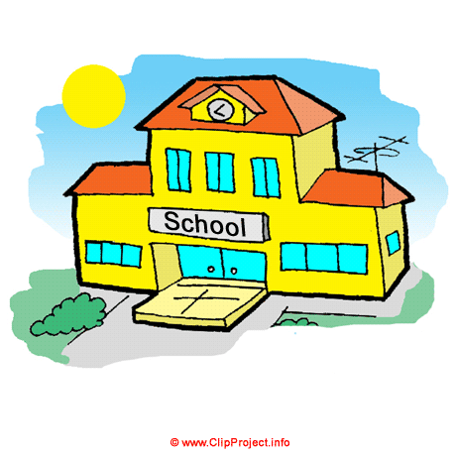
A typical school day.
▪ School starts at 10;00
▪ Leasons
▪ Breaks

Slide 4
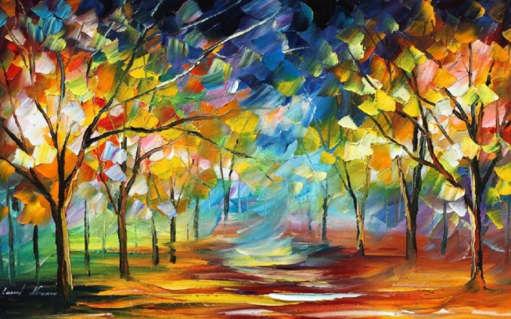
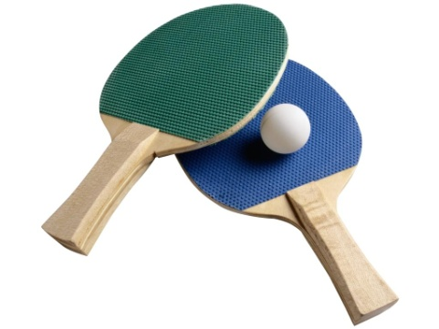
After school
▪ After-school clubs
▪ No homeworks
▪ School trips

Slide 5
Thank you for attention.

