Slide 1
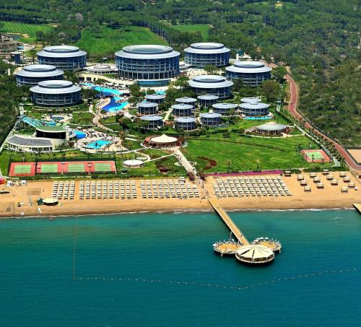
Ideal School.
Karīna Spunde and Laura Brāle 8.b klase

Slide 2
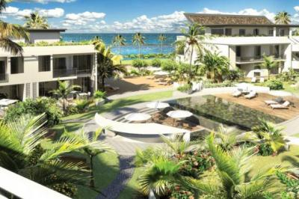
Our ideal school is near the ocean. It’s a boarding school for boys and girls. There are uniforms and rules. The school has got a swimming pools and a computer for every student and a room.In every class there are 30-35 students. Every student have to pay 1000 euro per year.
At 8:30 every student have to do morning aerobics, then at 9:30 – breakfast, at 13:00- lunch, at 18:00- dinner. There are 5 breaks 20 min long.

Slide 3
Rules.
Can’t use your own computers, but only school computers.
You have to wear school uniform every day.
You have to clean your room every week.
Can’t make noise.
Cant’t break school equipment.
You have to wear special shoes.

Slide 4
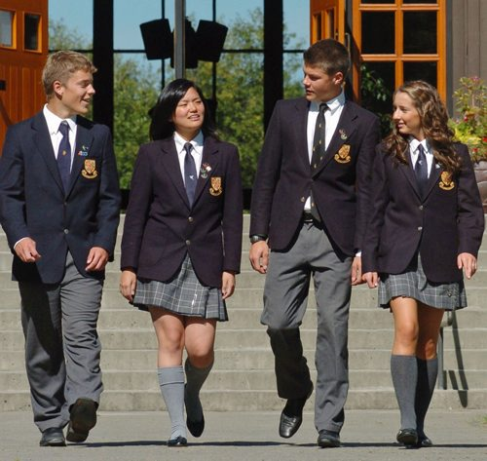
School uniform.

Slide 5
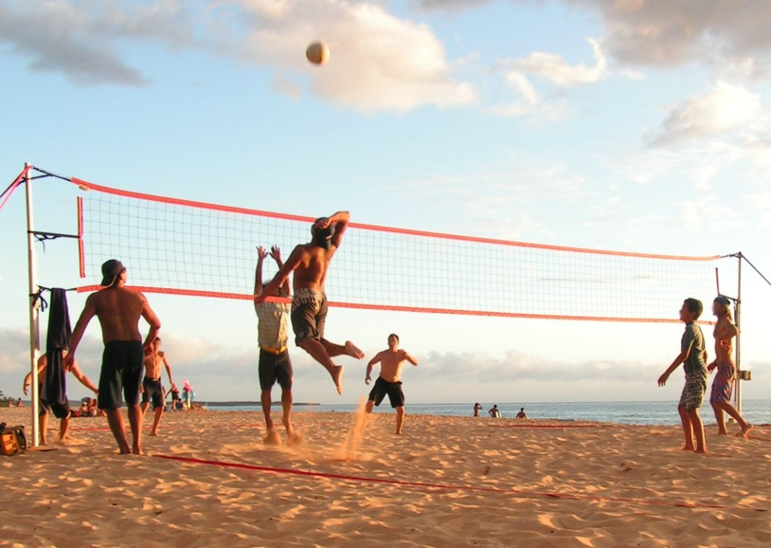
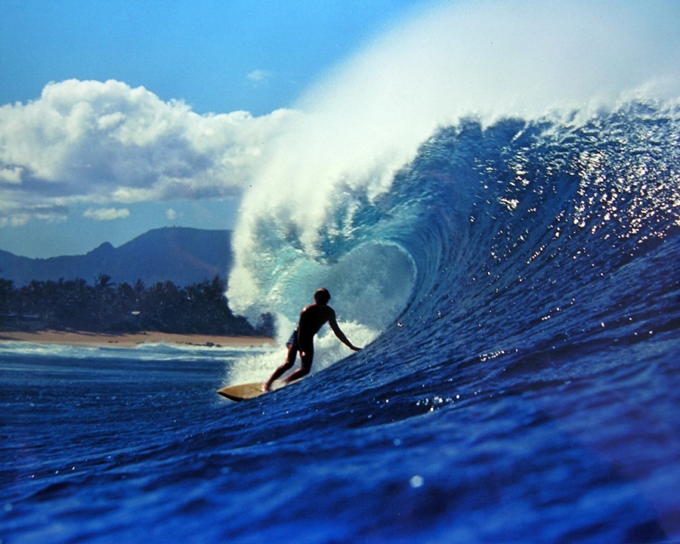
After-school clubs.
You can choose what you want to do:
Art club;
Cookery;
Dance;
Drama club;
Swimming;
Surfing;
Photography;
Beach volleyball;
Basketball;
Baseball.

Slide 6
School trips.
Each year, the whole school is going to hike. It is about 15 km long and there will be different tasks.
Each class goes 2 times a year to school trip.
Every year class who learn the best are going to travel around europe.

Slide 7
Thanks for watching and we hope that you want to be in this school!

