Slide 1
Our Ideal School

Slide 2
Boarding School Complex

Slide 3
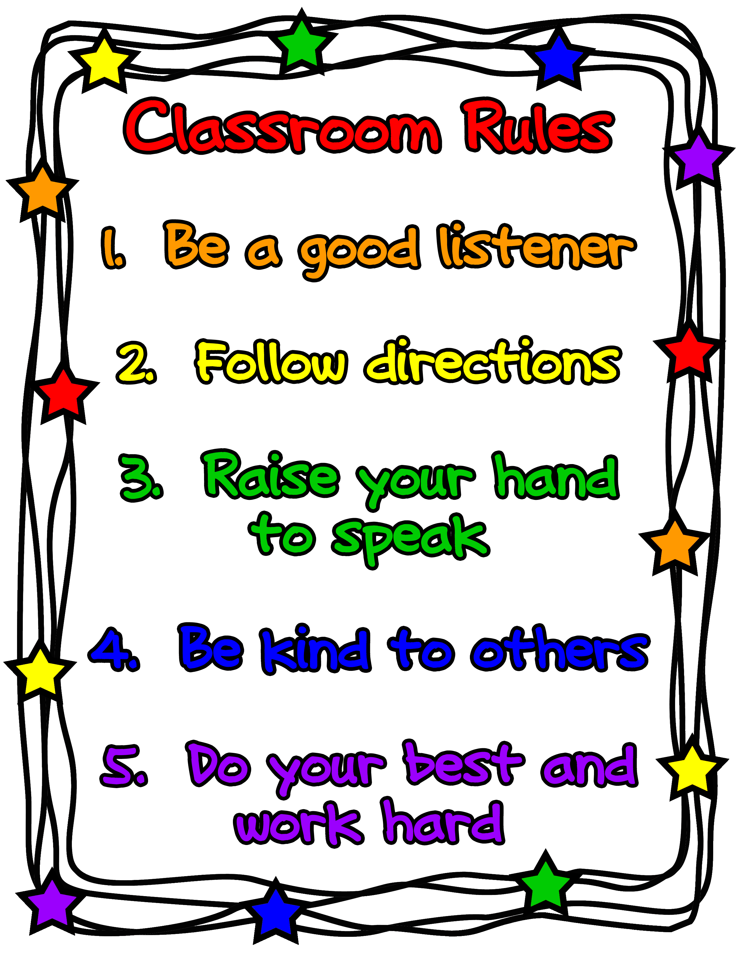

Slide 4
School Uniforms

Slide 5
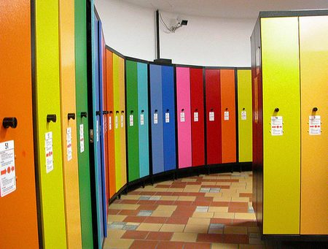
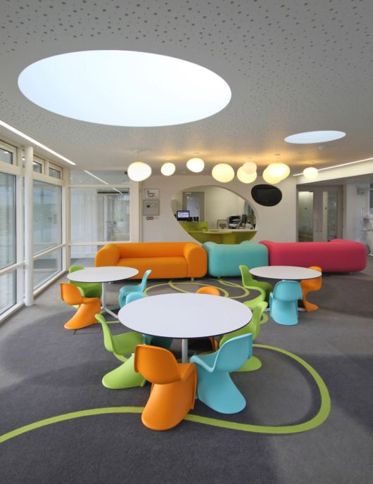
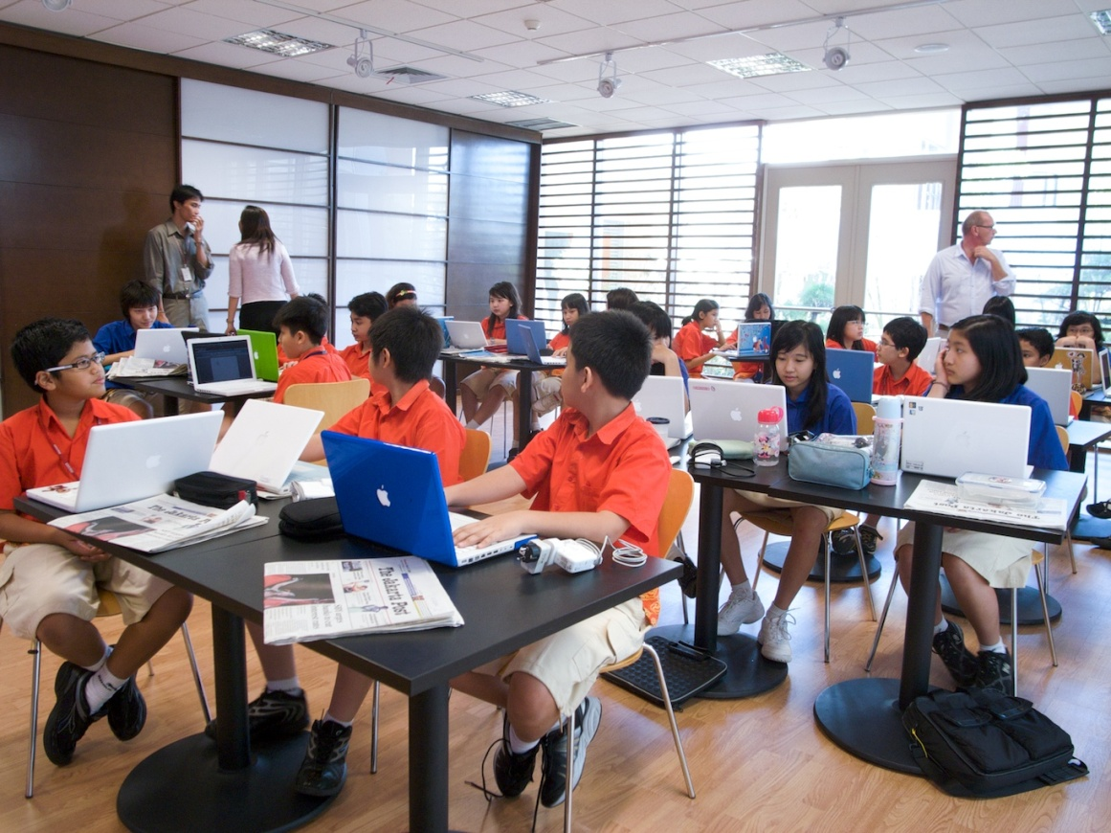
Lockers for Personal Things
Classes
Fun Zone

Slide 6
Lessons
Sports
Chemestry
Foreign languages
Maths

Slide 7
School Cafeteria

Slide 8
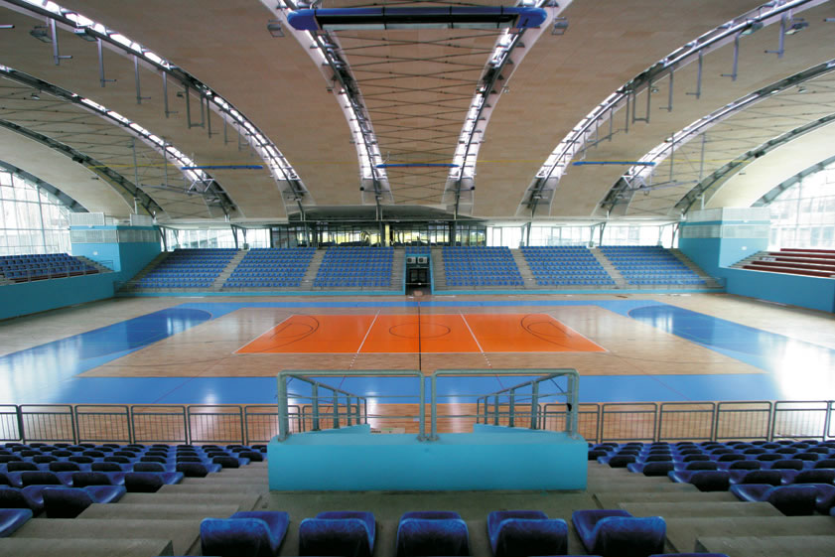
Sports Lessons

Slide 9
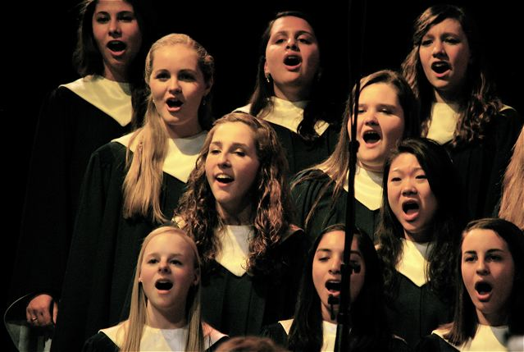
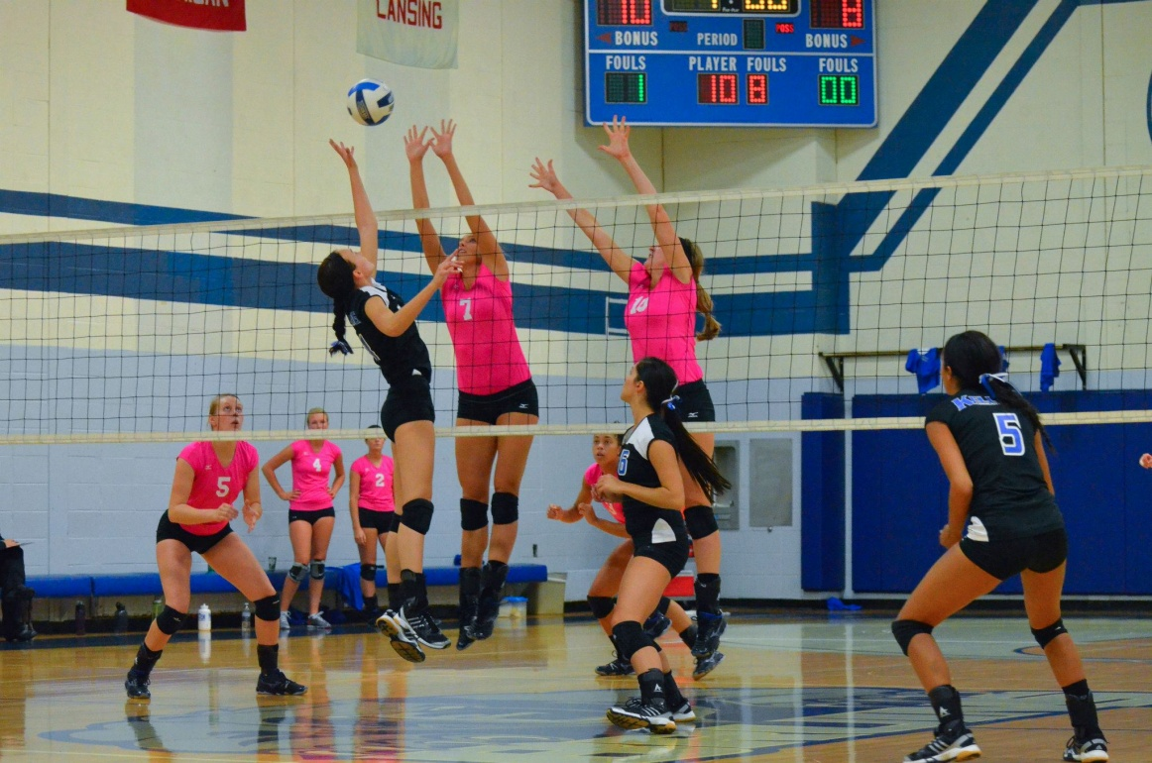
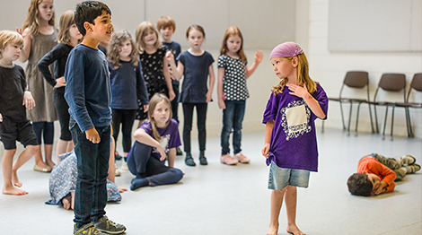
Cheerleaders
Choir
Sports Clubs
Theatre

Slide 10
School Trips

Slide 11
Thanks for Watching!

